Slide 1
Predicting Cardiovascular Disease Risk
Presented BY : Neha M
Date : 01.05.2024

Slide 2
Introduction:
Cardiovascular disease is a leading cause of mortality worldwide, accounting for a significant portion of deaths annually. Early detection and prediction of risk Cardiovascular disease can help in implementing preventive measures and interventions to reduce morbidity and mortality rates associated with the disease. The purpose of this project is to develop machine learning models to predict the 10-year risk of developing Cardiovascular disease based on various demographic, lifestyle, and clinical factors.

Slide 3
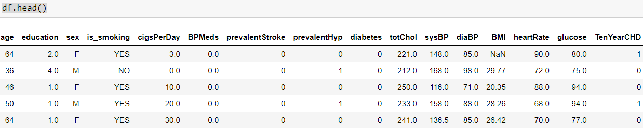
Dataset Overview:
Dataset Description: The dataset used in this project contains 3390 instances and 17 features.
Features: The dataset includes demographic information, lifestyle factors, and clinical measurements such as age, gender, blood pressure, cholesterol levels, etc.
Target Variable: The target variable is the 10-year risk of developing CVD (TenYearCHD).

Slide 4
Data Preprocessing:
Loading the Dataset: The dataset was loaded using the Pandas library.
Handling Missing Values: Missing values were filled using the median value of each feature.
Handling Duplicates: The dataset has no duplicate values.
Dropping Insignificant Columns: The 'id' column was dropped.
Feature Scaling: Numerical features were scaled using Min-Max scaling.
One-Hot Encoding: Categorical variables were encoded using one-hot encoding.

Slide 5
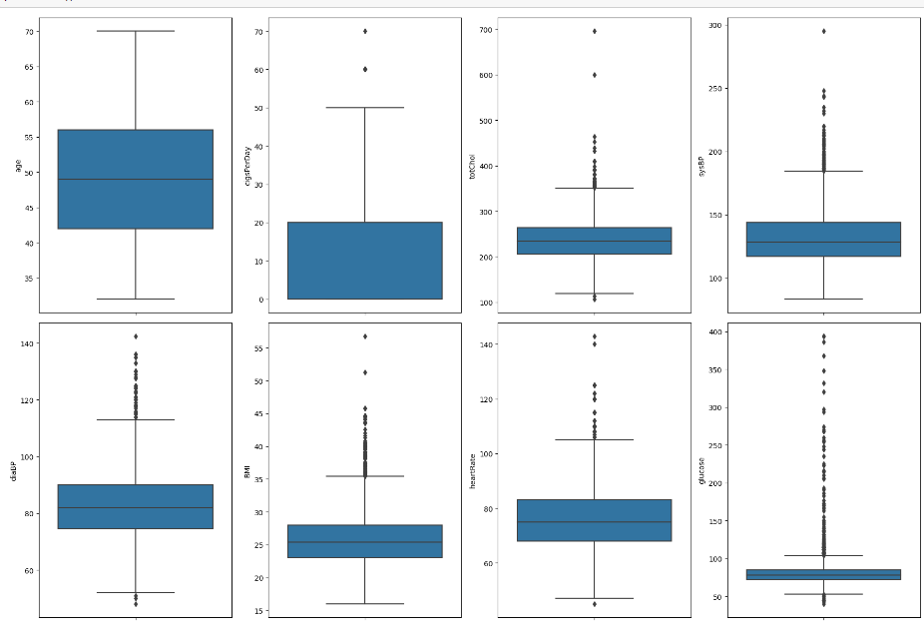
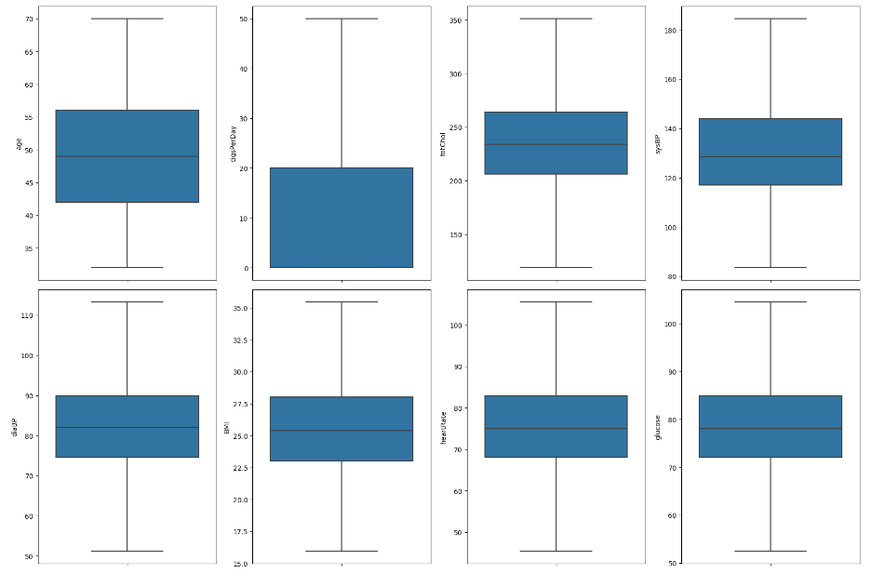
Handling Outliers: Outliers in numerical features were capped using the interquartile range method.

Slide 6
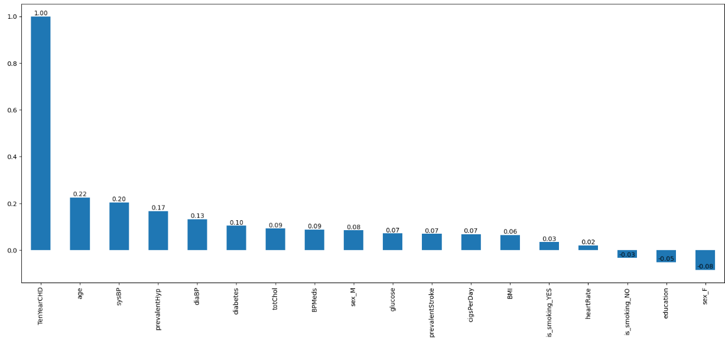
Exploratory Data Analysis:
Check the relationship of target variable with the features
Observation : The target variable(TenYearCHD) has strong positive relationship with age, systolic BP and prevalent hypertension compared to other features. It has a weak negative relationship with patients who don’t smoke , education and female patients.

Slide 7
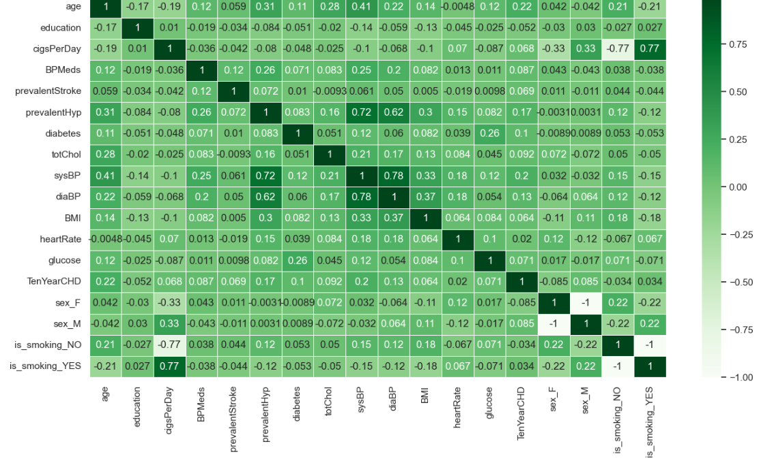
Check for correlation between the variables.
Observation : From above we can infer that,
Number of cigarettes per day is strongly correlated a smoker
Systolic BP is strongly correlated to diastolic BP
Systolic BP is directly proportional to Prevalent Hypertension

Slide 8
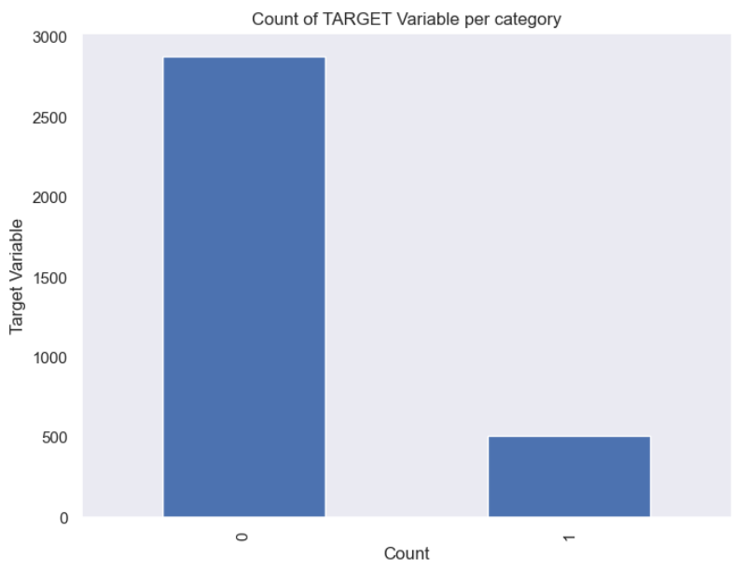
Handling Imbalanced Dataset:
The imbalance in the distribution of the target variable
(TenYearCHD) was addressed using the Synthetic
Minority Over-sampling Technique (SMOTE) to
generate synthetic samples.

Slide 9
Model Building:
Split the data into training and testing set:
The data has been split in the ratio 80:20
The Machine Learning Models used in the project:
Logistic Regression
Random Forest Classifier
XG Boost

Slide 10
Model Evaluation: Then Moment Of Truth
The accuracy scores of the models used in the project are as follows:
Logistic Regression : 0.703
Random Forest Classifier: 0.916
XG Boost: 0.890
From the above scores, it is clear that Random Forest Classifier is the best model to be used in this classification problem.

Slide 11
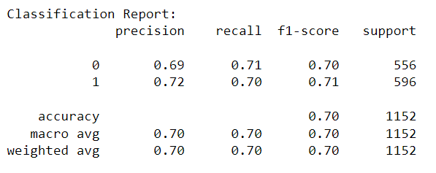
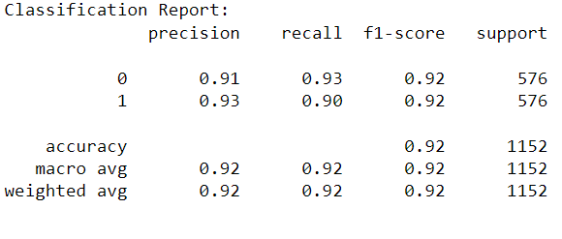
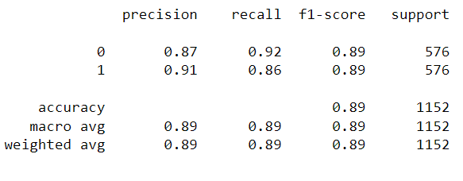
Classification Report:
Logistic Regression
Random Forest Classifier
XG Boost

Slide 12
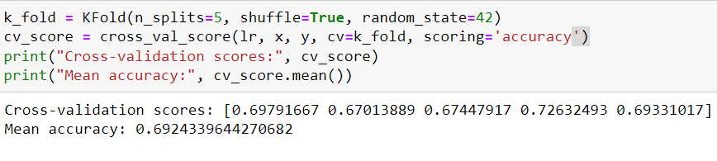
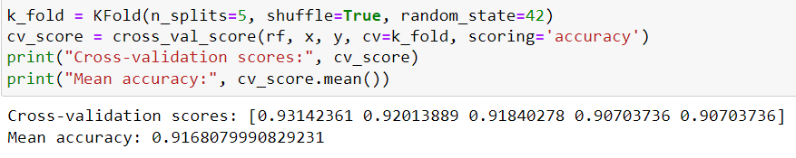
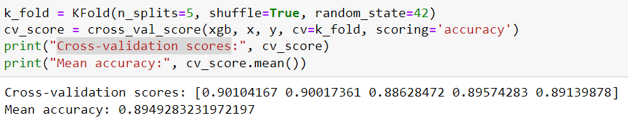
Cross-validation scores:
Logistic Regression
Random Forest Classifier
XG Boost
From above, it is clear that none of the models have Overfitting problem since the accuracy scores are consistent over all the folds.

Slide 13
Conclusion:
In conclusion, our journey through the realm of cardiovascular disease risk prediction has been both enlightening and empowering. By leveraging the power of data science and machine learning, we have uncovered valuable insights and developed predictive models capable of identifying individuals at risk of developing cardiovascular disease.
With respect to the three models used in the project , Random Forest Classifier has emerged has the reliant model with an accuracy of above 90% .
Armed with this knowledge, we have taken a significant step towards early detection and intervention, ultimately working towards a future where proactive healthcare measures lead to healthier and happier lives.

Slide 14
THANK YOU!

